Slide 1



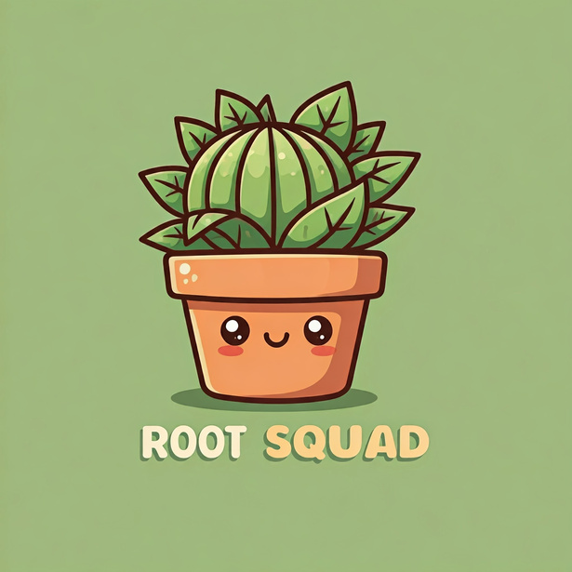
Junior Full-Stack Developer Programme
Capstone Project Presentation

Slide 2


Contents
01 Our Team
Who we are and What we do?
05 ERD Model
Entity Relationship Diagram Model
09 Lessons learned
Accomplishments & Challenges
02 About Us
What is Rootsquad?
06 App Demo
Rootsquad in action
10 Future Wishlist
Next steps
03 Tech Stack & Tools
Skills and Tools utilised
07 Timeline
Our Project Roadmap
11 Conclusion
Final Words
04 Key Features
Key features in Rootsquad
08 BSM
Behavioral skills & Mindset

Slide 3


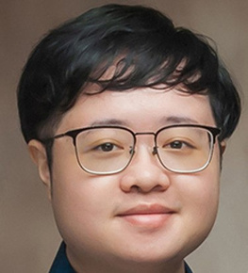
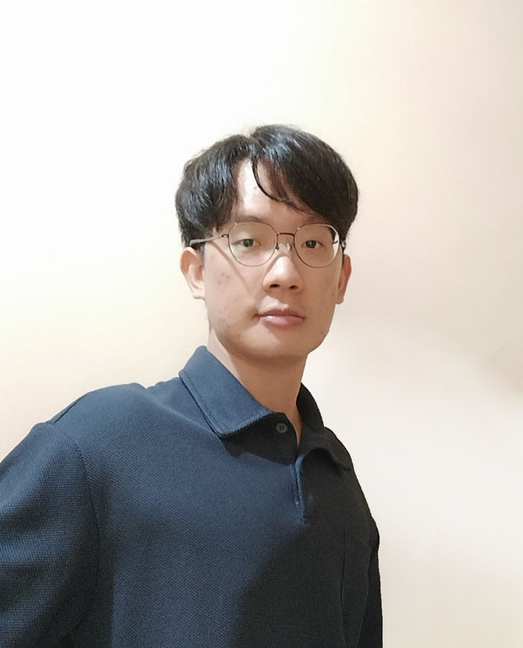
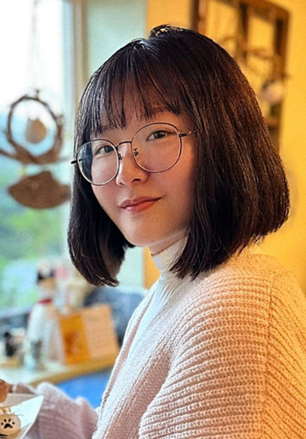
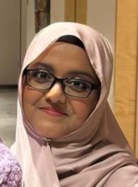
THE ROOTSQUAD TEAM
Chan Jia En
Goh Jin Ying
Ui design
Front-end Development
Server-side Development
Presentation
Ui design
Front-end Development
Presentation
Gina Lim
Shazana
Ui design
Front-end Development
Presentation
Ui design
Front-end Development
Presentation

Slide 4





WHAT IS ROOTSQUAD?

Slide 5

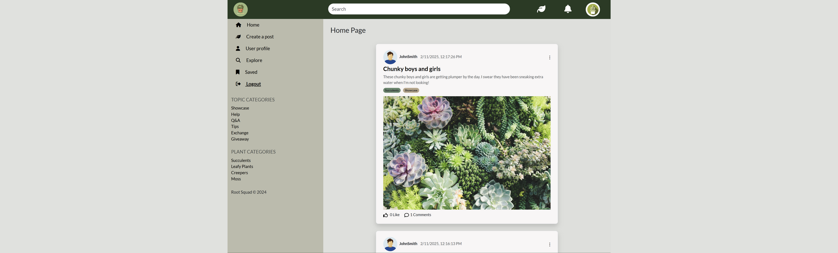

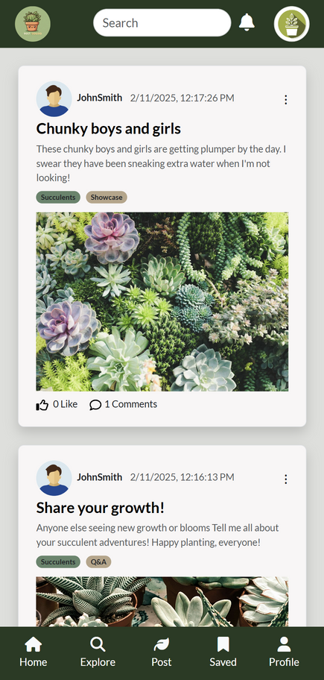

A social media and community forum app for plant lovers
Our app connects people who love house plants, where you can share tips, plant stories, and meet new plant enthusiasts.

Slide 6
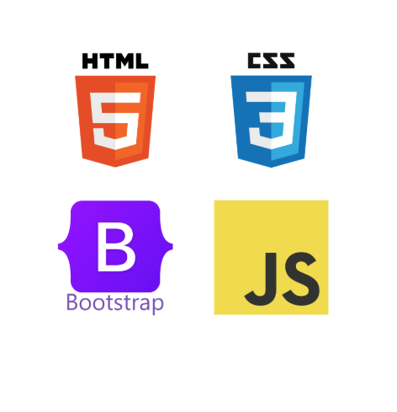


Skills and Tools Utilised in the Project
Front-End
Back-End
Tools

Slide 7







KEY FEATURES
View a Post
Read and engage with individual posts
Responsive Design
Works on all devices seamlessly
Scrollable Home Feed
See new posts in a smooth, endless scroll
List by Categories Organize posts based on plant types & care
Create a Post
Share your plant updates and tips
Search Posts
Find plant-related posts easily
List by Topics Browse posts grouped by topic

Slide 8

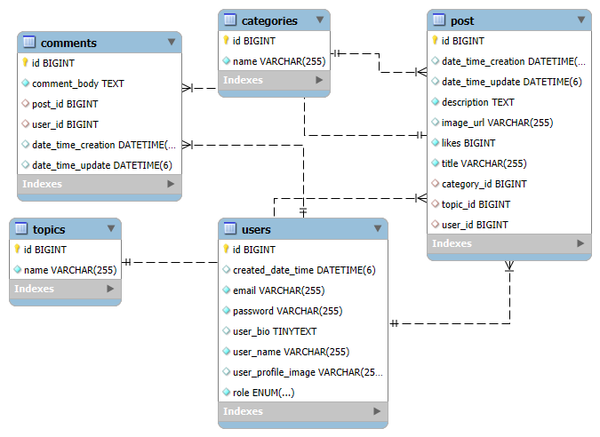
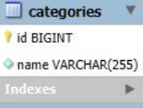
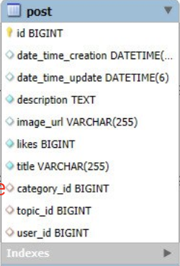
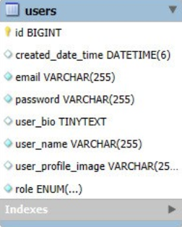
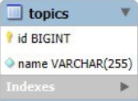
Entity Relationship Diagram (ERD)

Slide 9

SOFTWARE DEVELOPMENT TIMELINE
Nov 24
App Ideation
ERD Design
Oct 24
UIUX Design
HTML, CSS & Bootstrap
Dec 24
Frontend Javascript
Database design
Jan 25
Develop REST apis for database operations
Feb 25
Deployment

Slide 10
User Flow Diagram
Sign in/ Sign up
Home Feed
View Post
Create Post
View Post
Search Page
List by Search Page
View Post
List by Topics Page
View Post
List by Category Page
View Post
Profile Page
About Page

Slide 11







Product demo

Slide 12
BEHAVIOURAL SKILLS & MINDSET
Growth Mindset
& Persistence
Future
Orientation
Teamwork
We faced challenges such as troubleshooting bugs and incorporating our desired features, but we managed to pushed on and accomplish them
Manage our short and long-term goals and proactively work on them to achieve success for the capstone.
Ensured constant communications and check-ins on each other’s progress and render support to each other when required, e.g. bug fixing or implementing complex features.

Slide 13




Accomplishments and Challenges
Accomplishments:
Challenges Overcame:
Built a full-stack web portal from scratch.
Integrated APIs for enhanced functionality.
Designed for responsiveness across devices.
Used version control for smooth collaboration.
Debugged complex issues to optimize performance.
Adapted quickly to new technologies and frameworks.
Collaborated effectively in a remote environment.
Balanced project scope between learning and practicality.

Slide 14


FUTURE ROADMAP / WISHLIST
Likes
Add friends
Search for User
Group meetups
Direct Messaging
Saved post
Stories

Slide 15
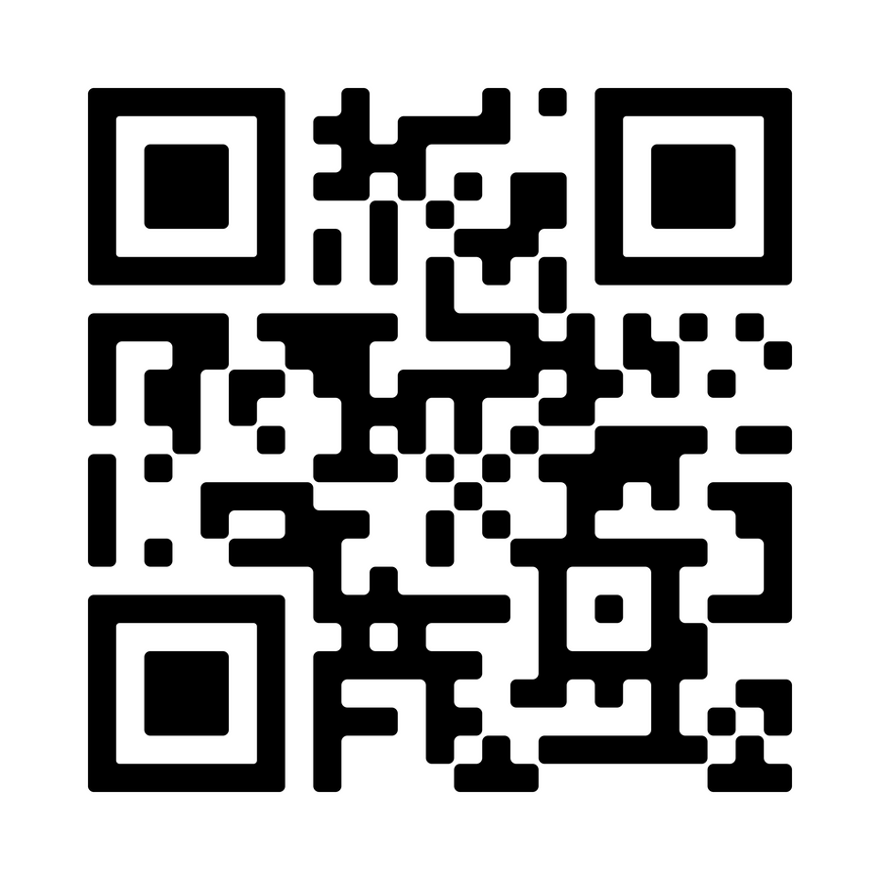
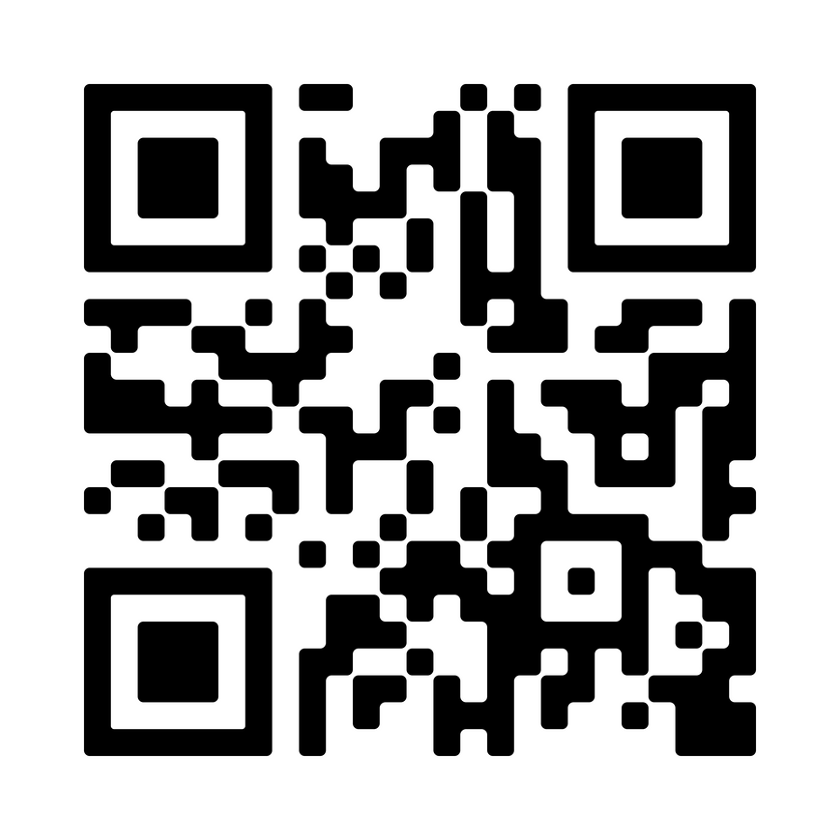
Thank you!!
Front-end
Github Link:
Back-end
Github Link:
https://github.com/Zoooriiel/team-1-repo
https://github.com/ChanJESG/team-1-repo-backend
Special thanks to: Advisor & Instructor Martin Leong

